Slide 1
Salience
a
MPTP
cortex
CONT
cerebral nuclei
hippocampus
thalamus
hypothalamus
midbrain
hindbrain
B
MPTP
cortex
ACU
cerebral nuclei
hippocampus
thalamus
hypothalamus
midbrain
hindbrain
C
MPTP
cortex
NA
cerebral nuclei
hippocampus
thalamus
hypothalamus
midbrain
hindbrain
Notes:
Salience
Cortex: S1, S2, M1, M2, Cg1, Cg2, Insul, Pir 순서대로 재정렬.
Hypothalamus: PVN, AH, LH, ARC, PH 순서대로 재정렬
-> 이후 모두 동일 순서로 재정렬.

Slide 2
Correlation
Notes:
Correlation-within group

Slide 3
Correlation with cutoff
Notes:
Network r² – within group - Threshold: 0.288 (no isolated node)

Slide 4
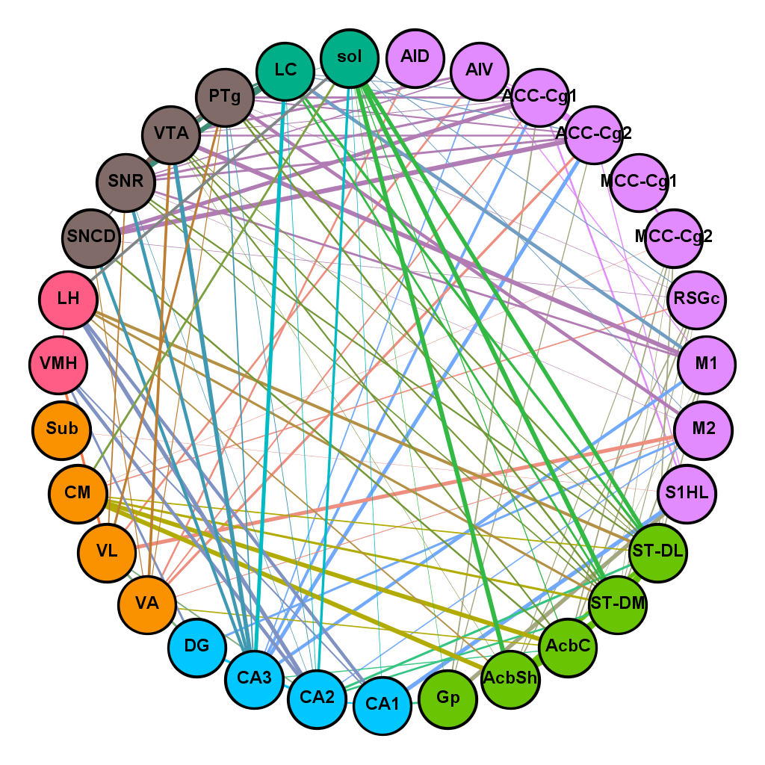
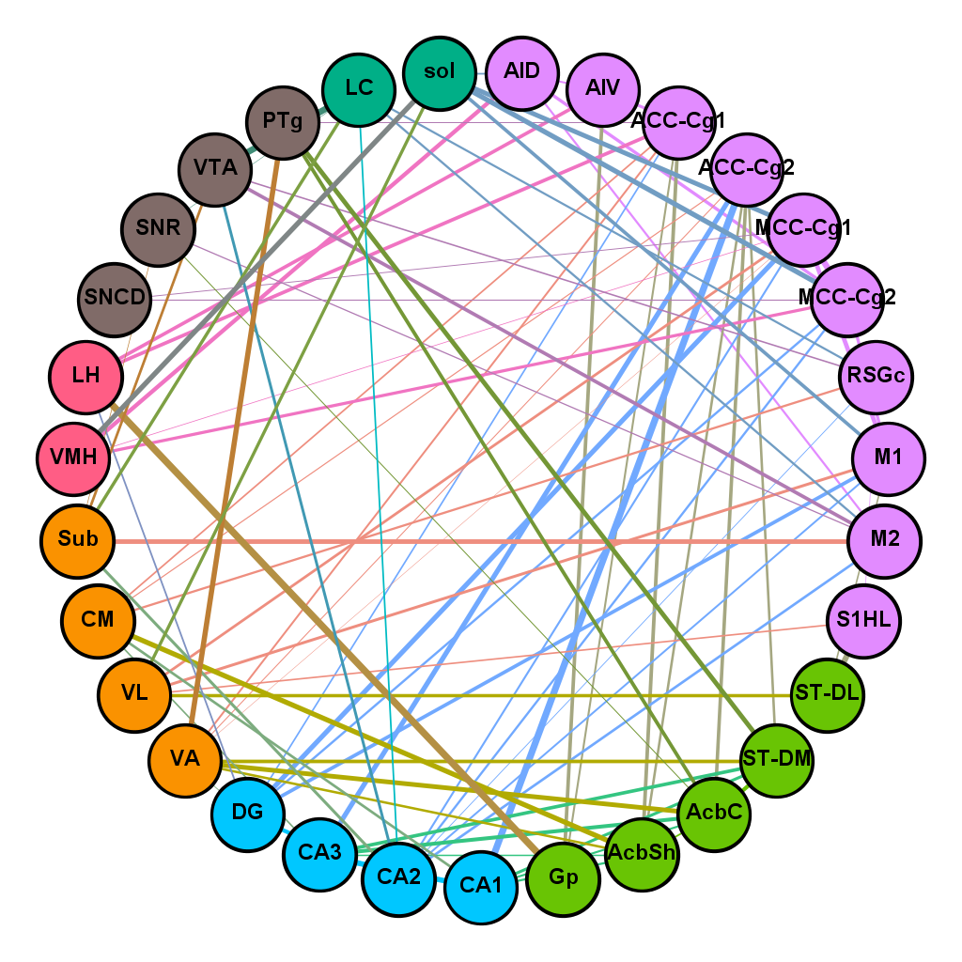
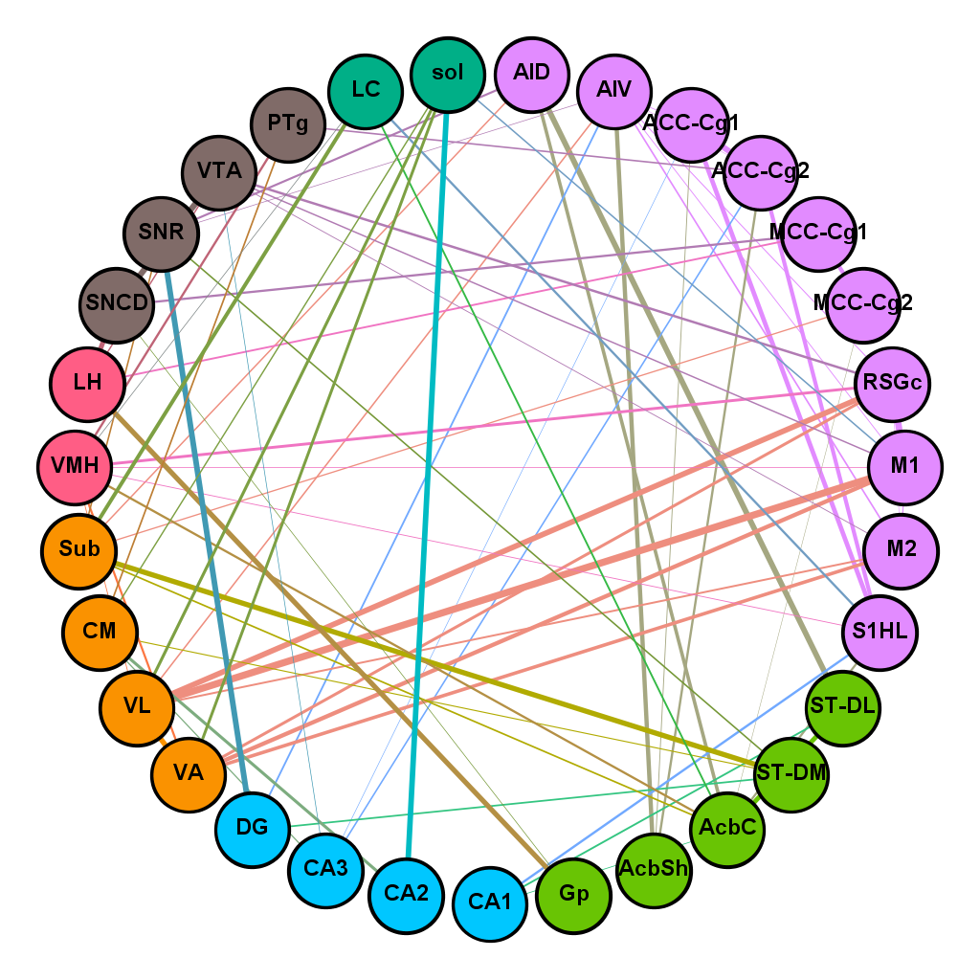
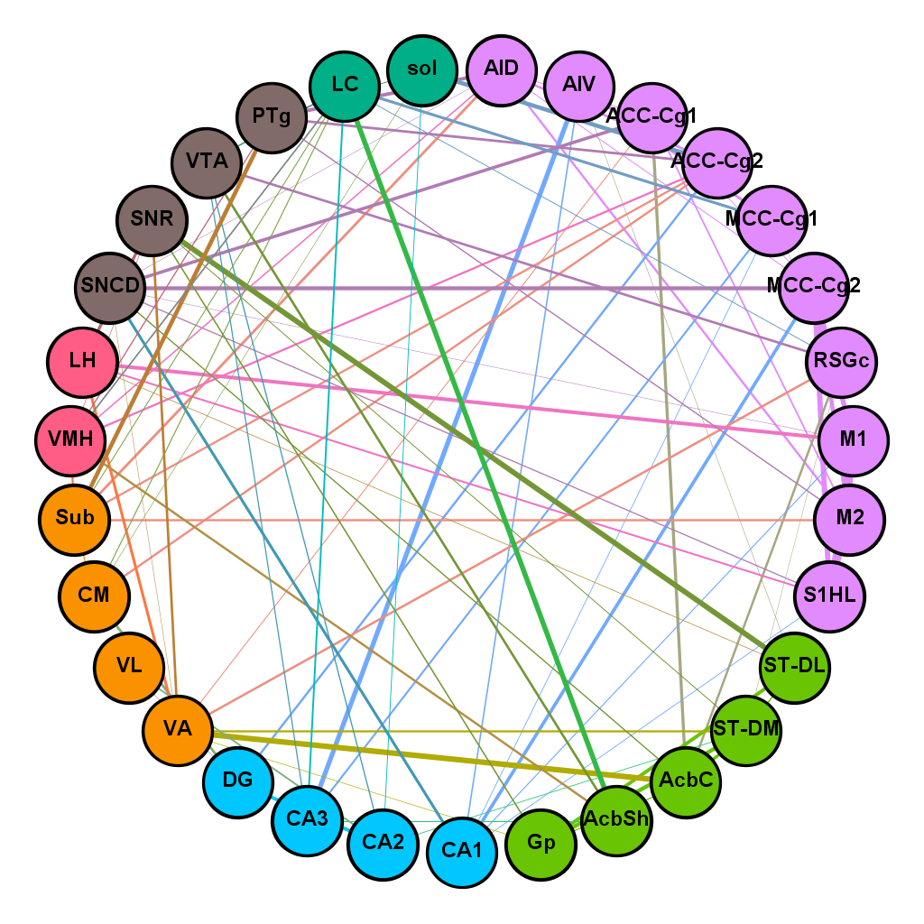
Network - circle
CONT
MPTP
ACU
NA
Notes:
Network r² – within group - Threshold: 0.288 (no isolated node)

Slide 5
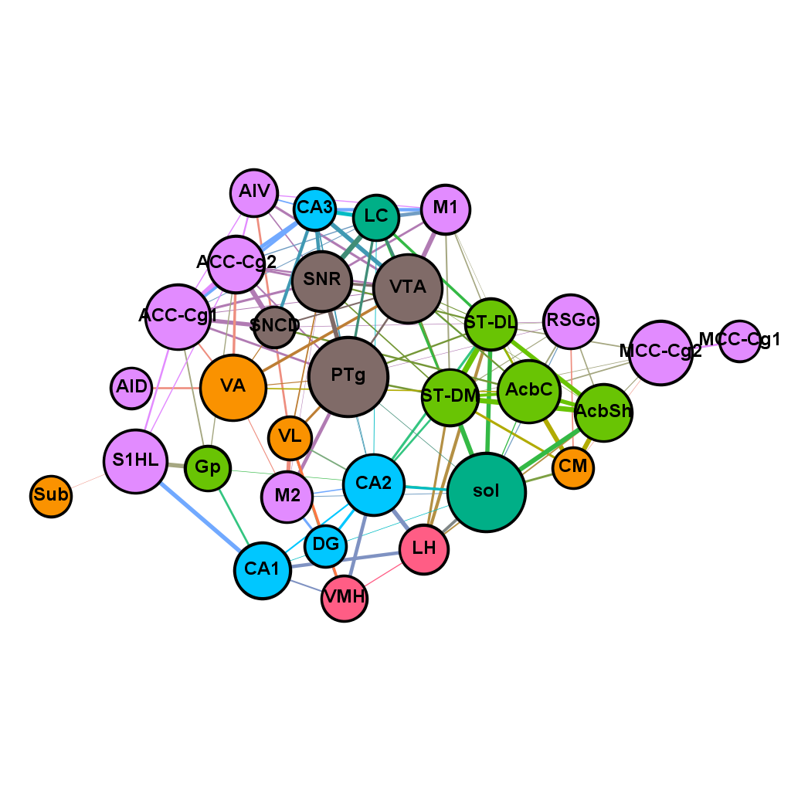
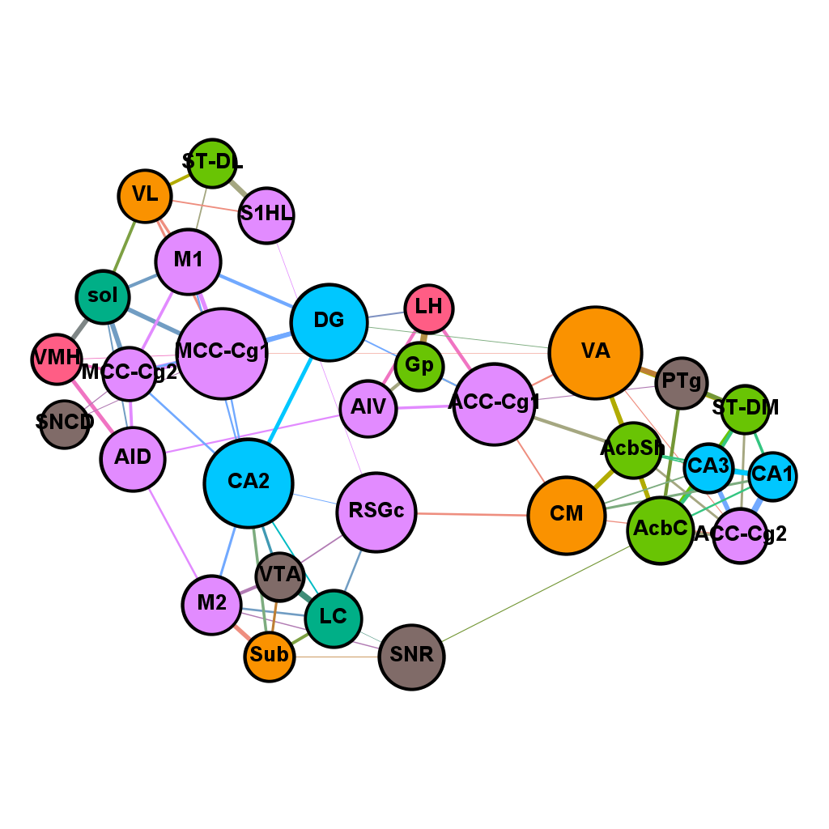
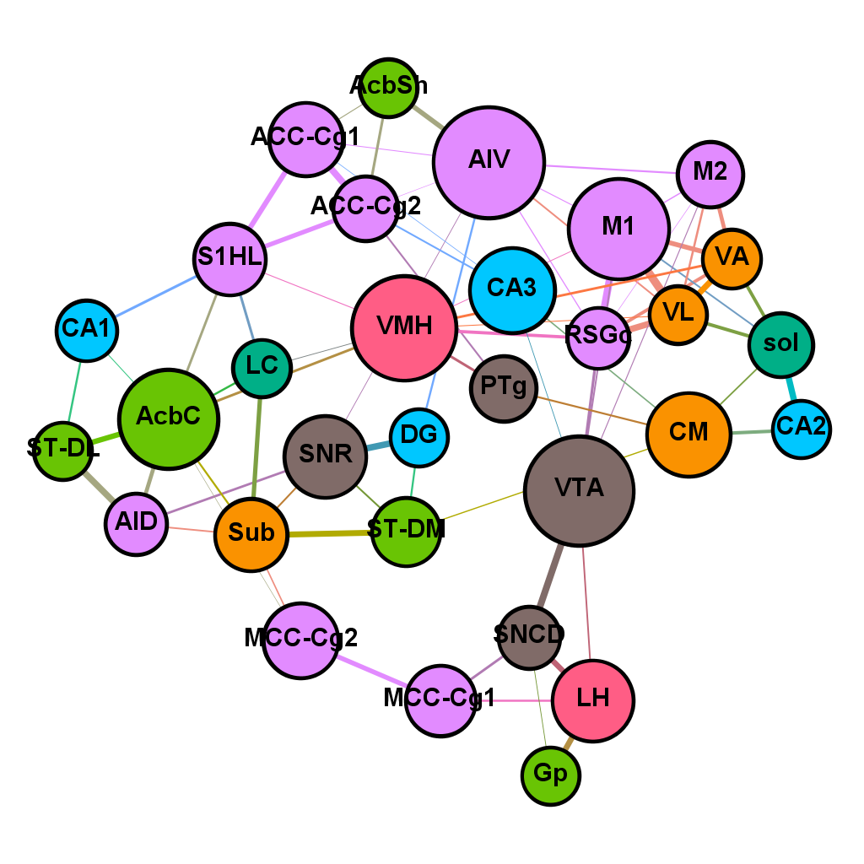
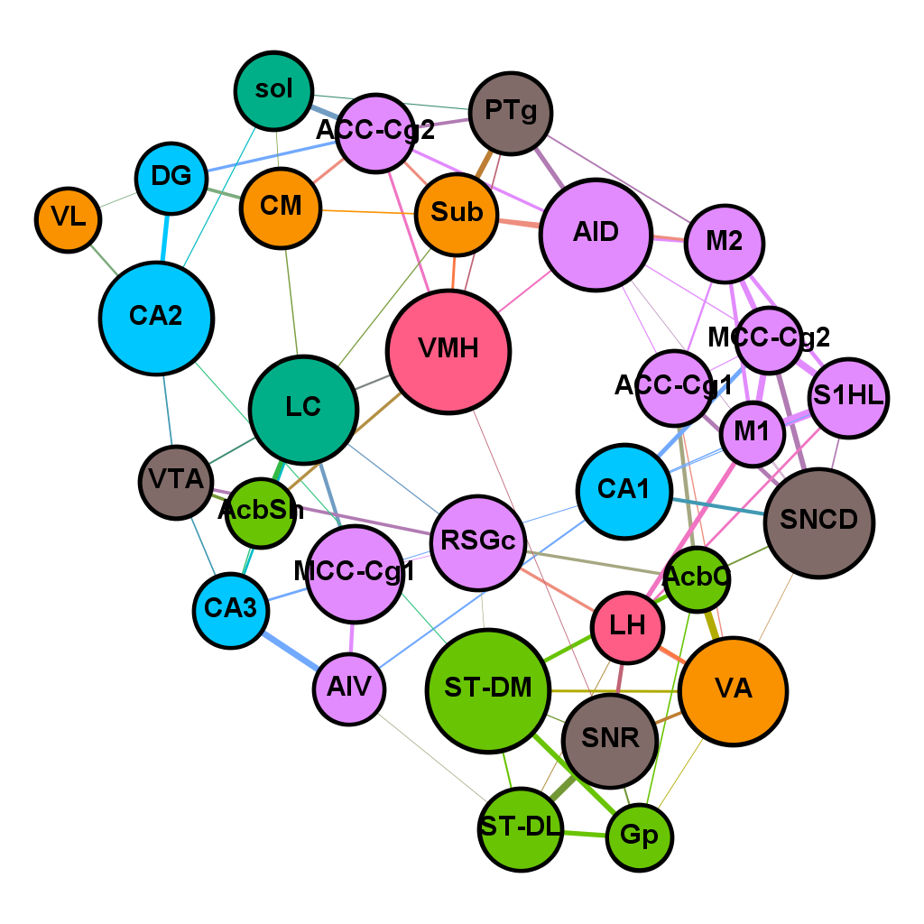
Network – force atlas
CONT
MPTP
ACU
NA
Notes:
Network r² – within group - Threshold: 0.288 (no isolated node)

Slide 6
Degree and Betweenness
VTA
PTg
sol
ACC-Cg1
MCC-Cg1
CA2
VA
AIV
M1
AcbC
VMH
AID
VA
SNCD
Notes:
Network r² – within group - Threshold: 0.288 (no isolated node)

Slide 7
Correlation sum by threshold
thres | CONT | MPTP | ACU | NA | ACU-MPTP
0.00 | 289.3 | 214.9 | 249.1 | 168.4 | 34.2
0.05 | 288.5 | 214.2 | 248.3 | 167.7 | 34.1
0.10 | 286.8 | 212.4 | 246.0 | 164.5 | 33.5
0.15 | 283.6 | 206.5 | 239.1 | 159.9 | 32.6
0.20 | 280.9 | 200.2 | 233.0 | 152.3 | 32.9
0.25 | 273.0 | 192.9 | 226.6 | 145.9 | 33.7
0.30 | 266.3 | 185.6 | 217.6 | 139.2 | 32.0
0.35 | 260.4 | 174.6 | 199.1 | 134.0 | 24.5
0.40 | 250.6 | 164.2 | 188.8 | 125.6 | 24.5
0.45 | 234.6 | 151.3 | 170.8 | 117.9 | 19.6
0.50 | 223.1 | 134.3 | 153.6 | 111.4 | 19.3
0.55 | 206.5 | 120.9 | 137.0 | 105.0 | 16.1
0.60 | 190.4 | 101.2 | 120.9 | 89.0 | 19.7
0.65 | 167.6 | 86.2 | 103.5 | 81.6 | 17.2
0.70 | 142.0 | 79.4 | 83.4 | 62.6 | 4.0
0.75 | 101.3 | 64.8 | 54.6 | 48.2 | -10.2
0.80 | 65.6 | 43.3 | 39.1 | 32.8 | -4.1
0.85 | 49.2 | 23.6 | 30.9 | 16.4 | 7.3
0.90 | 33.5 | 13.1 | 18.6 | 11.2 | 5.6
Notes:
Network r² – within group - Threshold: 0.288 (no isolated node)

Slide 8
Correlation with cutoff
r² ≥ 0.427 (no isolation)
r ≤ -0.6
-0.6 ≤ r ≤ 0.6
0.6 ≤ r
 | Corr sum | r² ≥ 0.427 | r ≤ -0.6 | -0.6 ≤ r ≤ 0.6 | r ≥ 0.6
CONT | 147.9 | 157.4 | -41.8 | -0.7 | 190.4
MPTP | 67.6 | 112.1 | -64.9 | 31.3 | 101.2
ACU | 150.1 | 90.6 | -20.7 | 49.9 | 120.9
NA | -7.2 | 105.8 | -67.1 | -29.1 | 89.0
Notes:
Network r² – within group - Threshold: 0.288 (no isolated node)

Slide 9
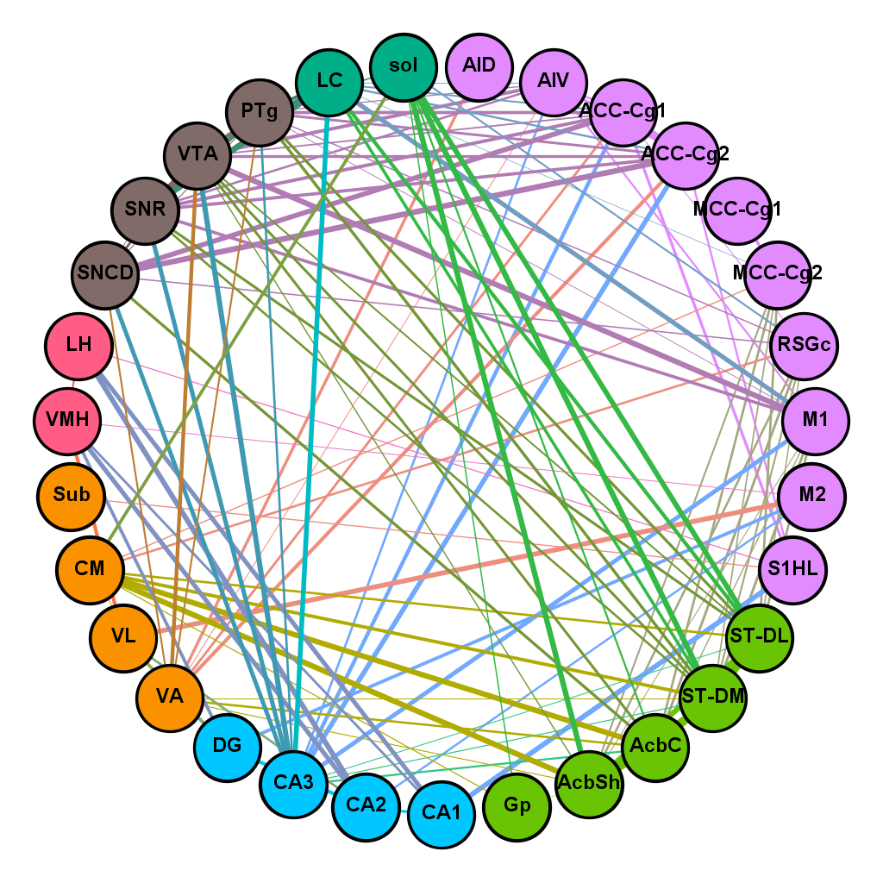
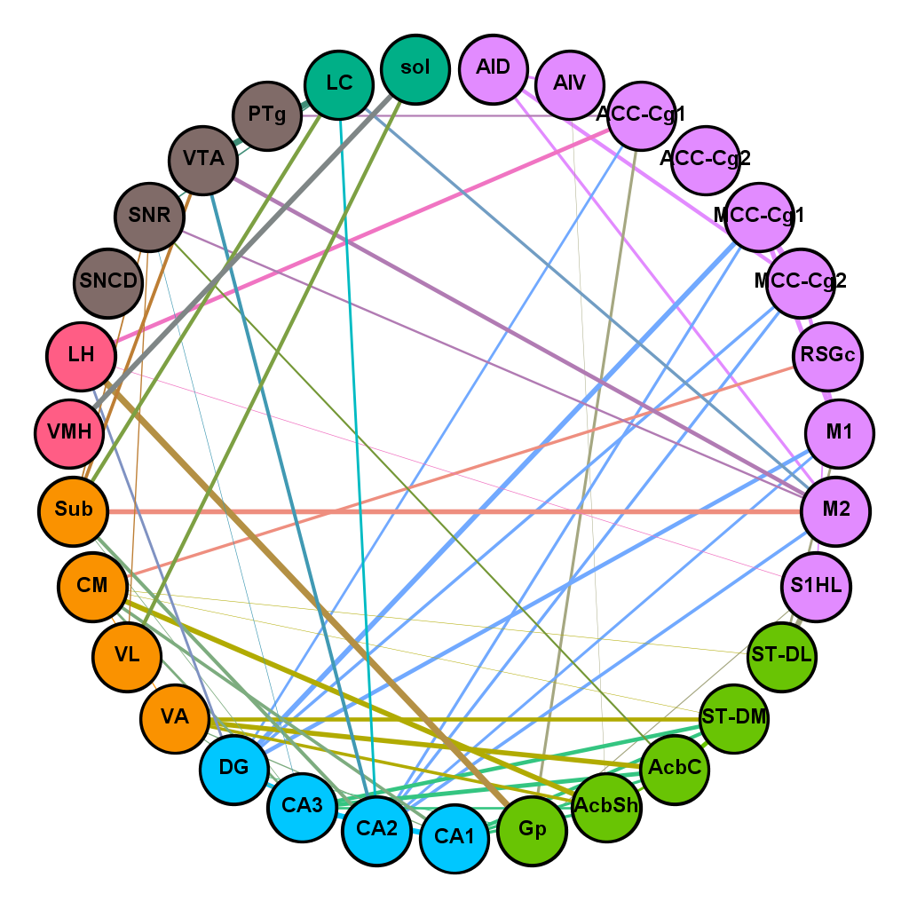
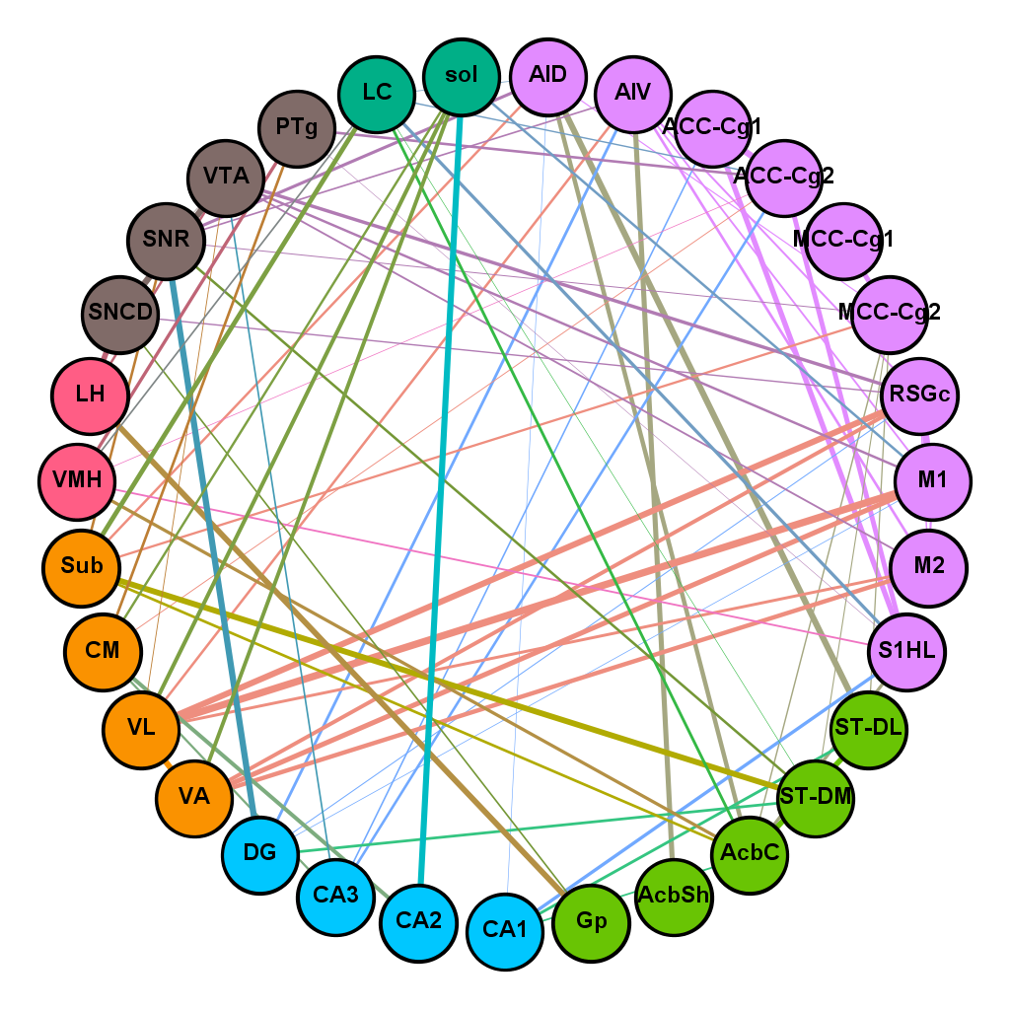
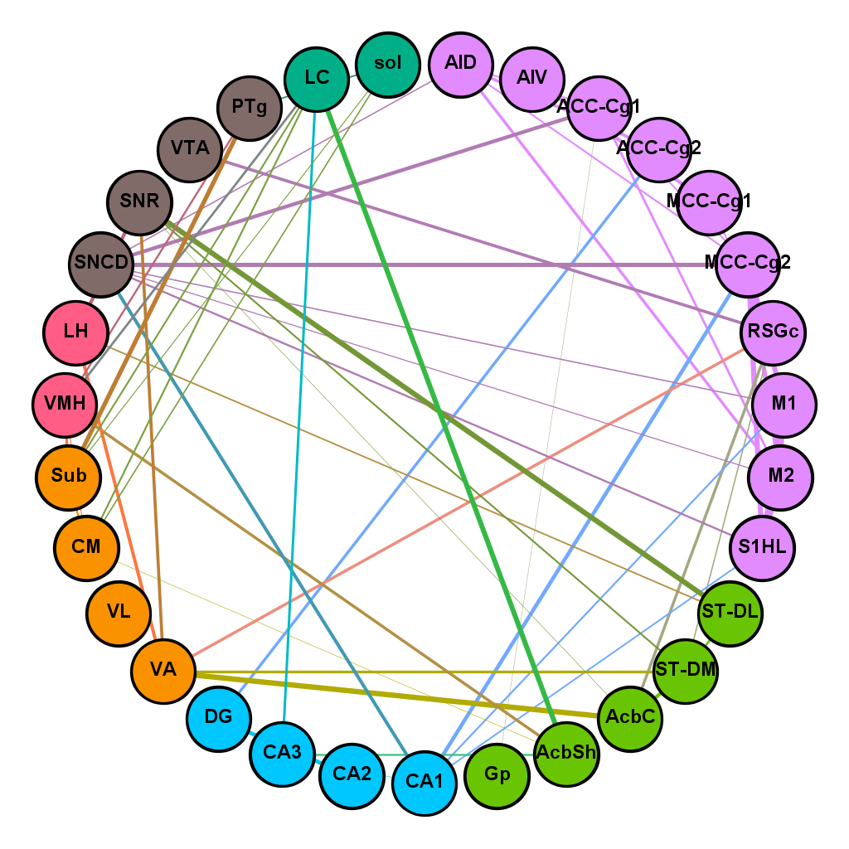
Network – circle (r ≥ 0.6)
CONT
MPTP
ACU
NA
Notes:
Network r² – within group - Threshold: 0.288 (no isolated node)

Slide 10
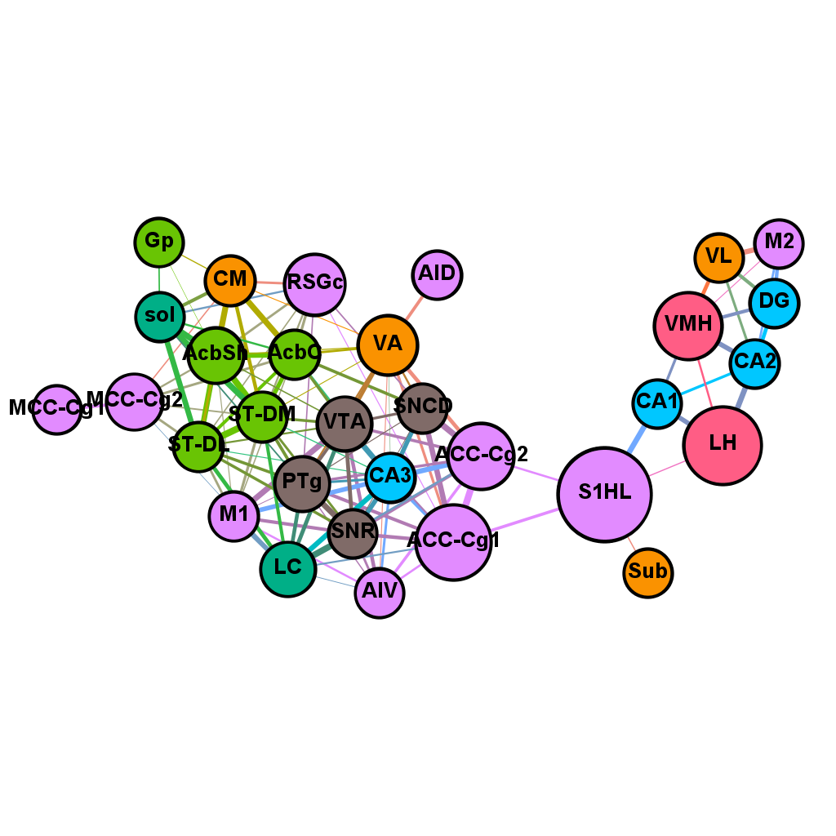
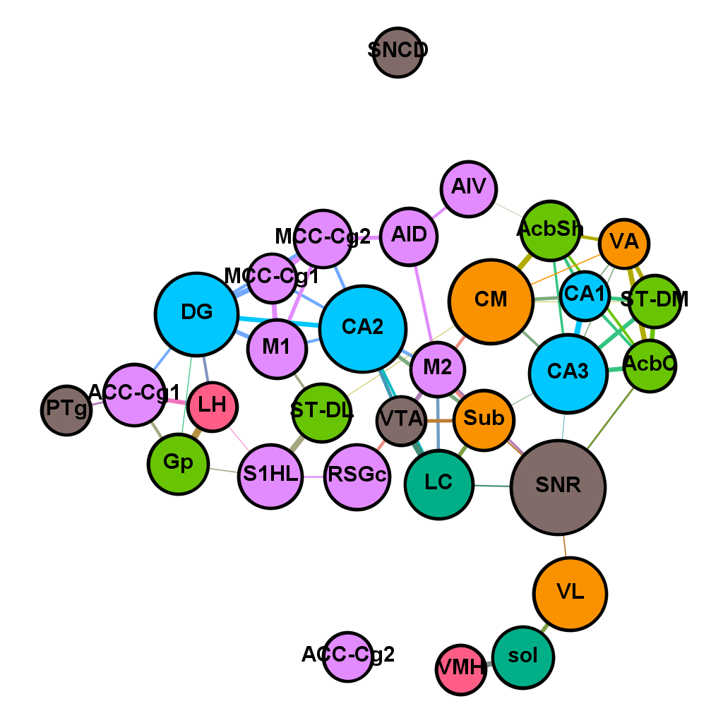
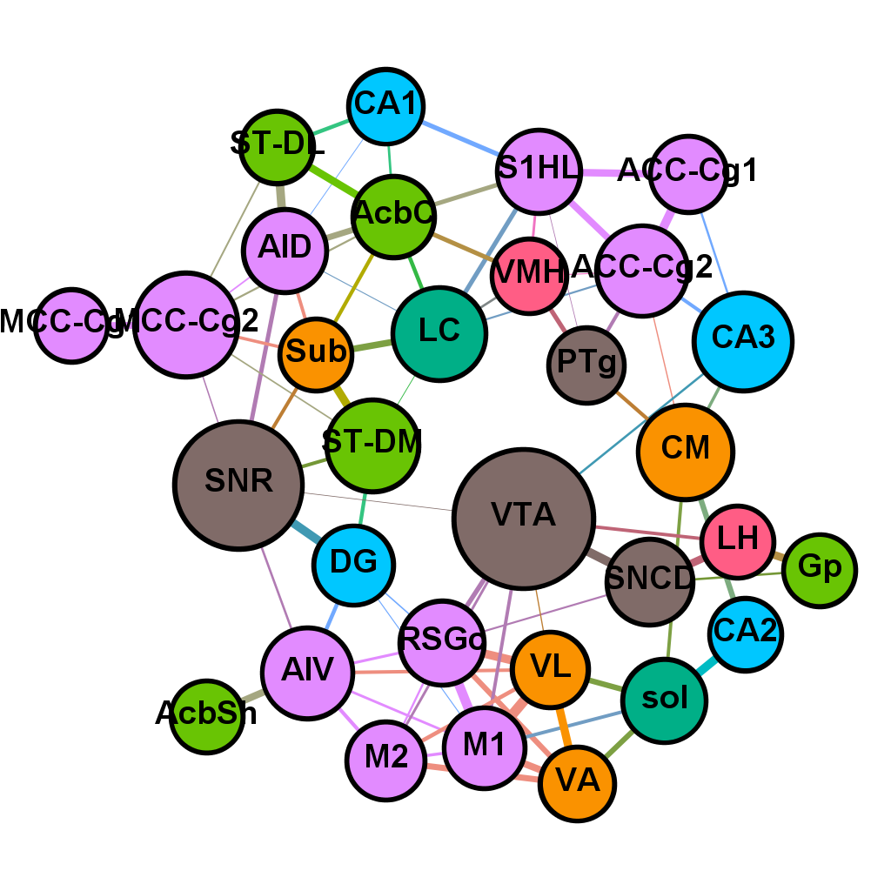
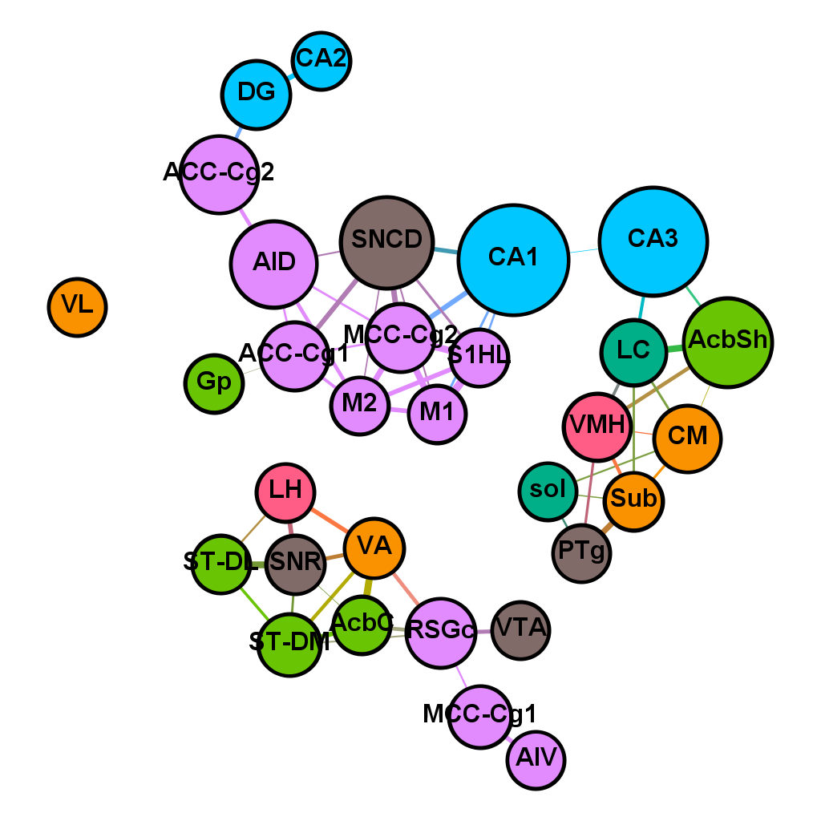
Network – force atlas
CONT
MPTP
ACU
NA
Notes:
Network r² – within group - Threshold: 0.288 (no isolated node)

Slide 11
Degree and Betweenness (r ≥ 0.6)
-
CA2
CA3
DG
CM
VTA
SNCD
Notes:
Network r² – within group - Threshold: 0.288 (no isolated node)

